Slide 1

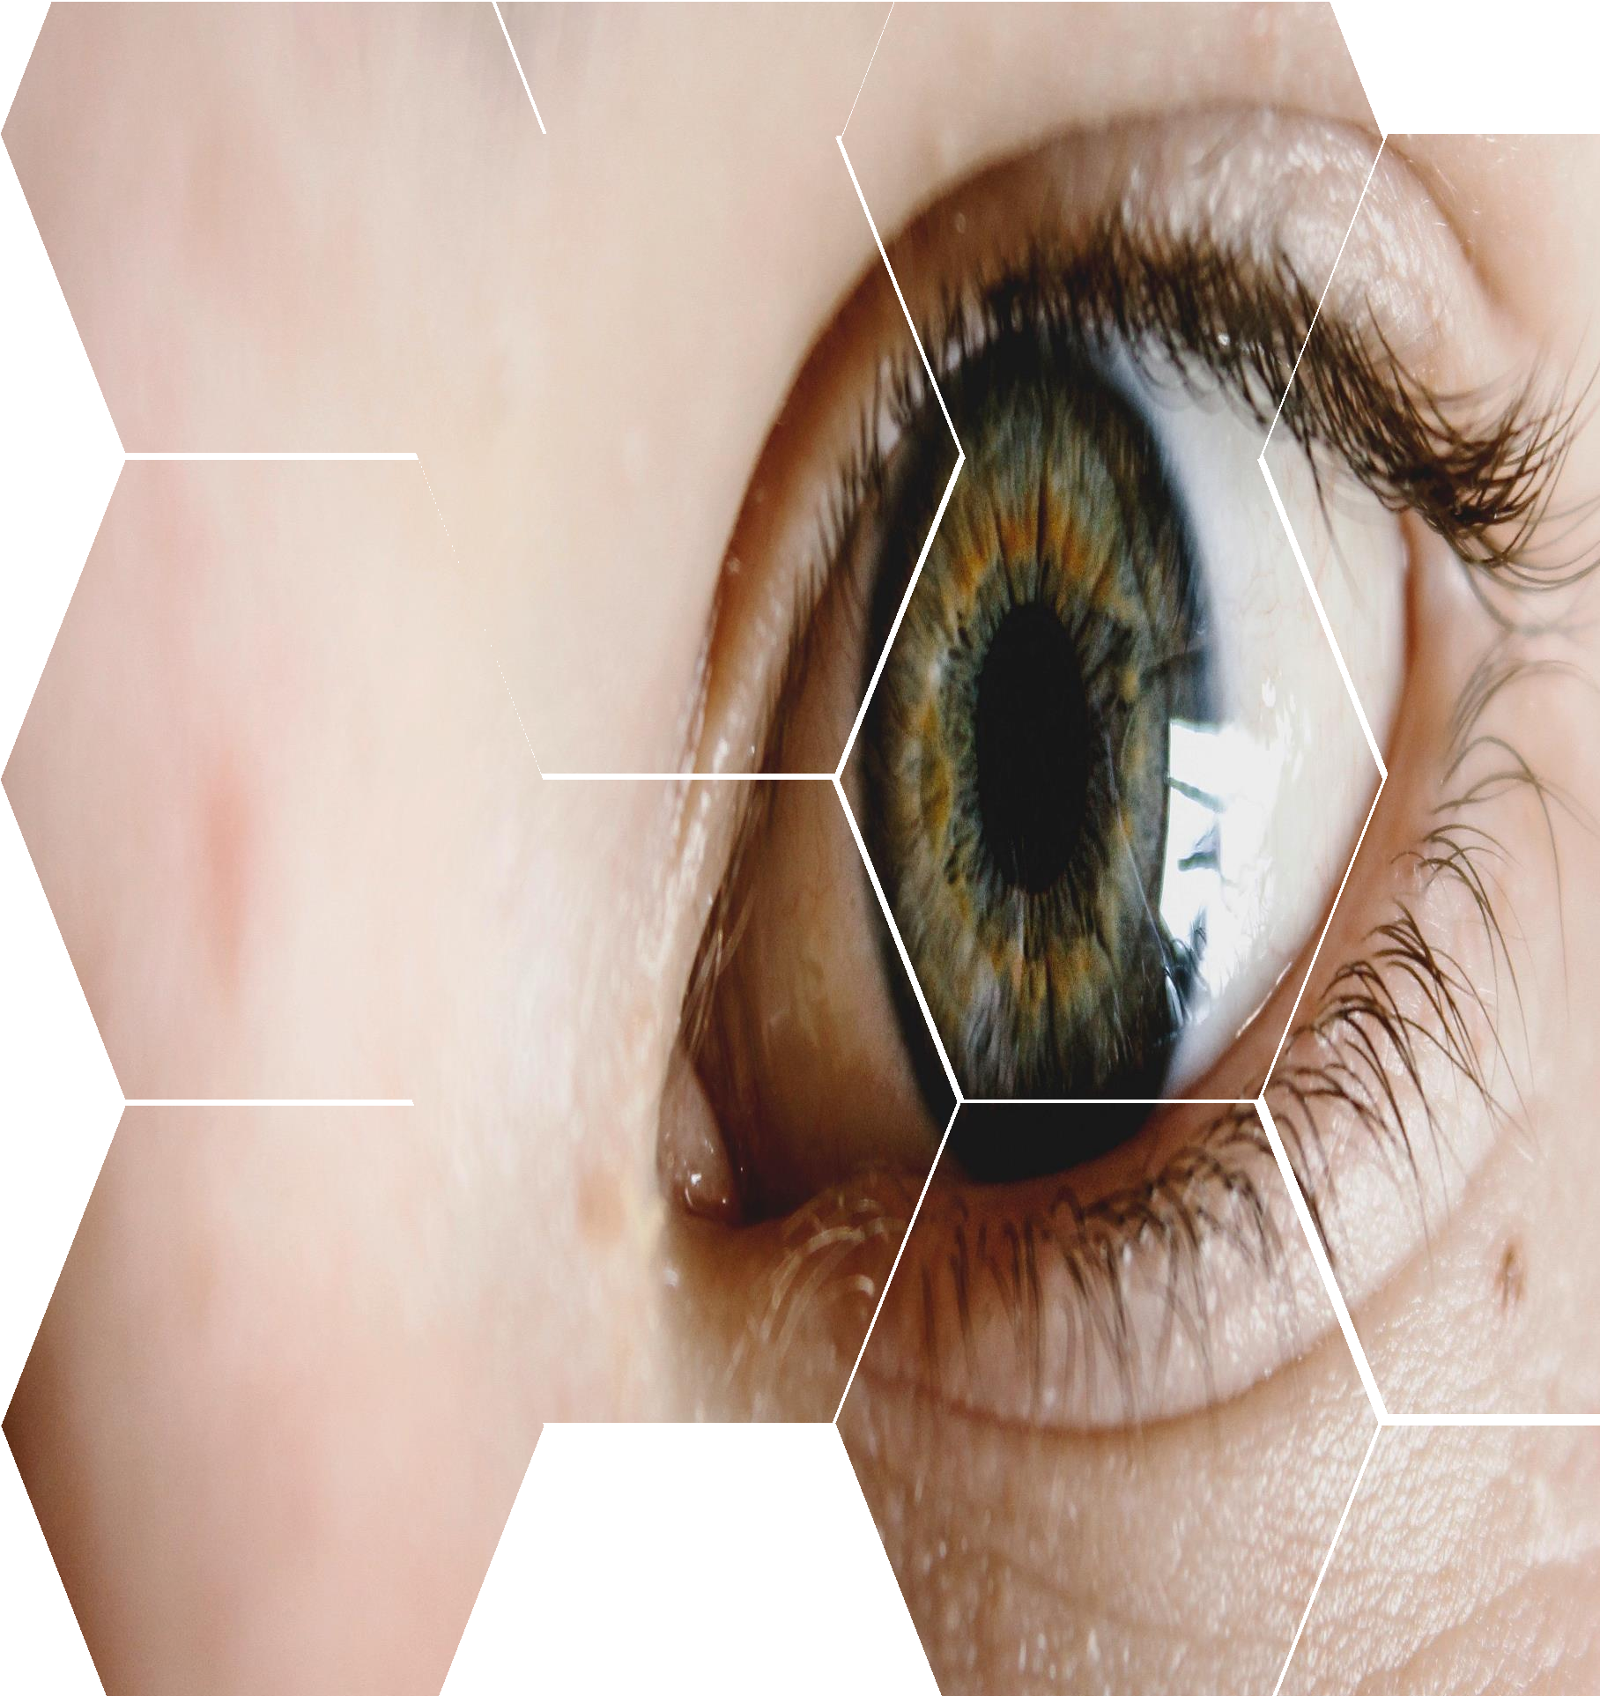

EyeVisionBridge

Slide 2
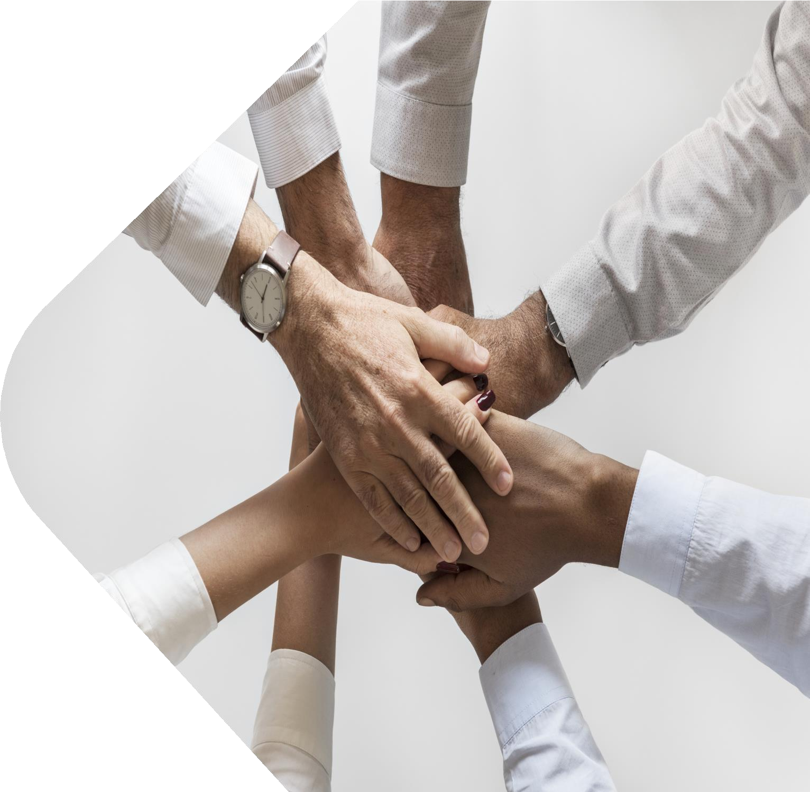
Eng: Badr Sayed
Under Supervision:
Team:
Maii Osama Abdelsabour
Sohaila Ahmed Mohamed
Alia Mohamed Abdelfatah
Zeina Mohamed Abdelhafez
Asmaa Galal Saeed

Slide 3





Table of content
Problems Definition
Objectives
Apps Used
Project Time Plan
Introduction

Slide 4
Eye VisionBridge
The Eye as a Health Indicator .

Slide 5

Eye VisionBridge
01 Diagnosing Diseases through Eye Examination .
The Eye as a Health Indicator .

Slide 6
Eye VisionBridge
01 Diagnosing Diseases through Eye Examination .
02 Instruct the patient about the type of examination required .
The Eye as a Health Indicator .

Slide 7
Eye VisionBridge
01 Diagnosing Diseases through Eye Examination .
02 Instruct the patient about the type of examination required .
The Eye as a Health Indicator .
03 Recommendations for the Best Specialized Doctors

Slide 8

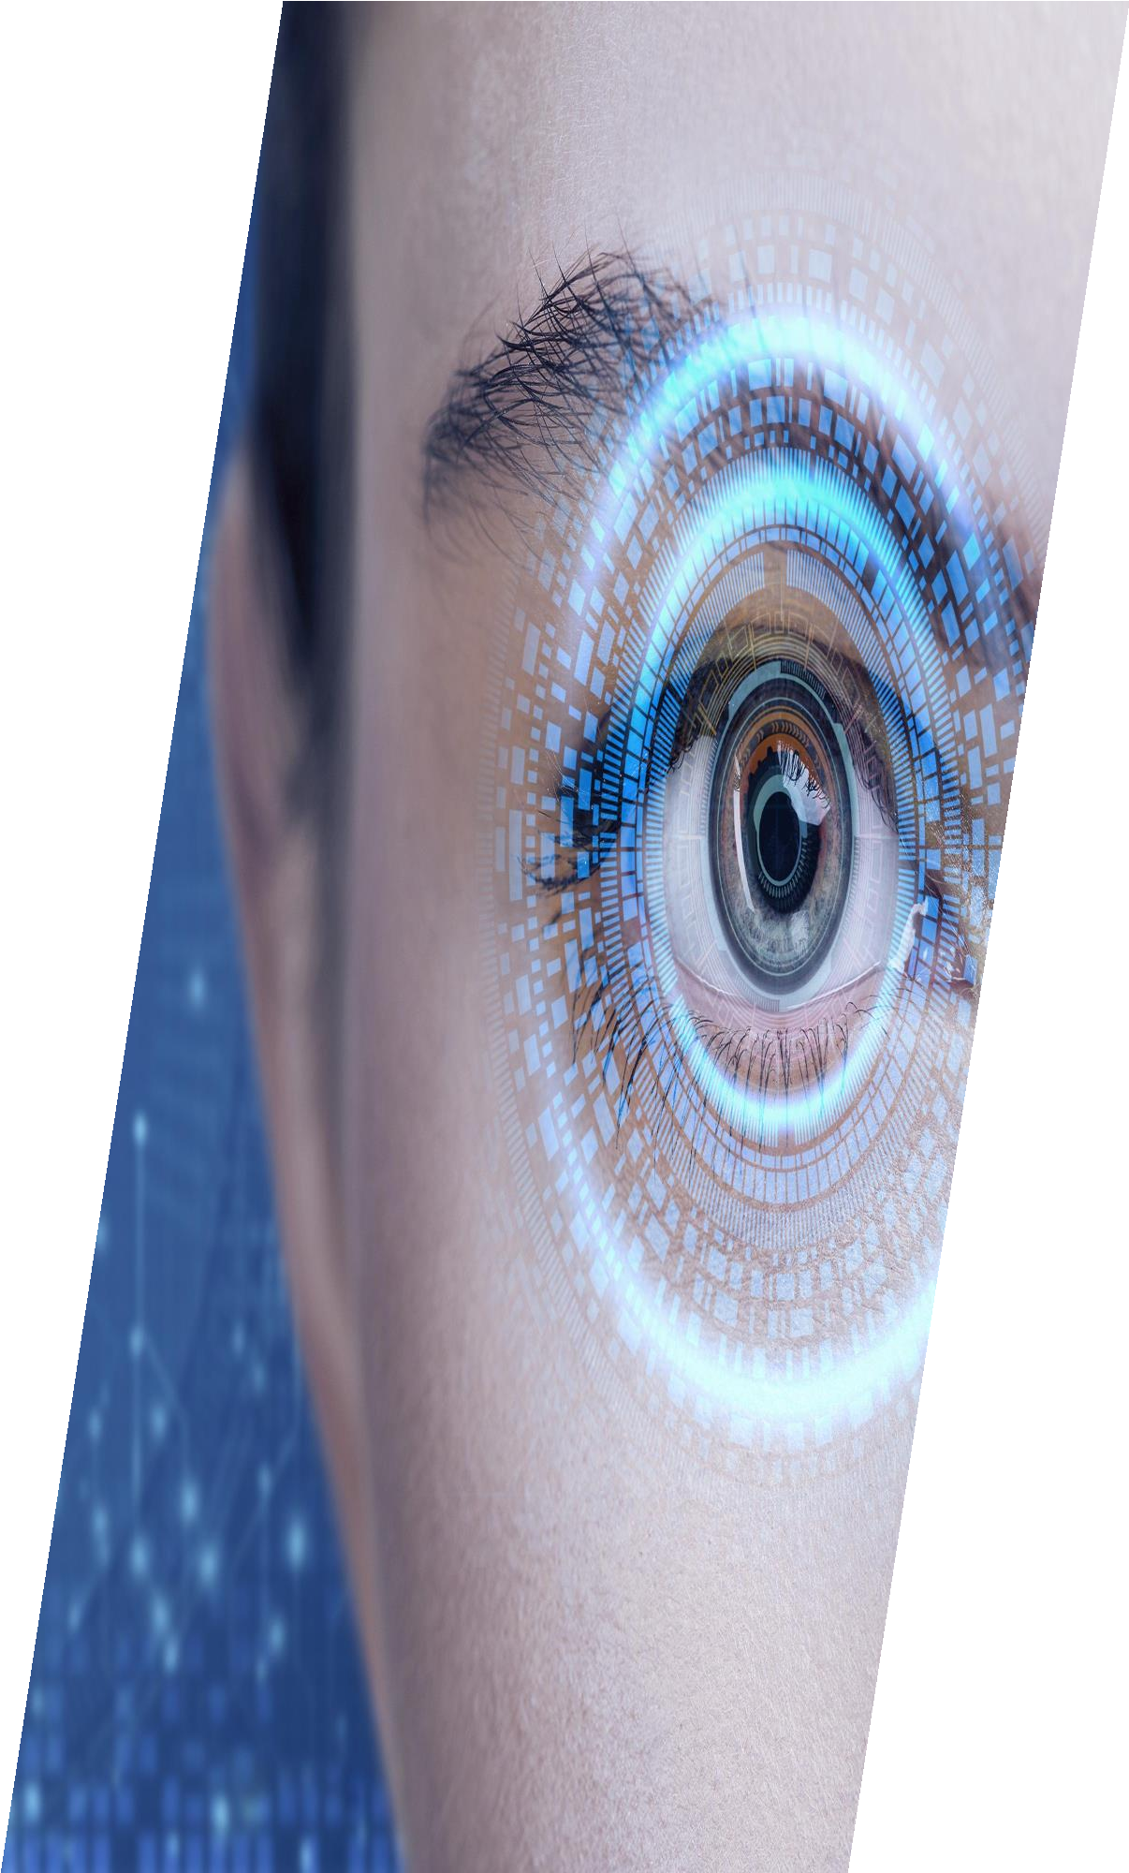
Introduction:-
EyeVisionBridge is a Mobile application made for : detection of body diseases through the eye is an innovative approach that utilizes advanced technology to analyze eye images and identify potential signs of various diseases or conditions. By examining the structures within the eye, such as the retina, blood vessels, and optic nerve, this program aims to aid in the early detection and diagnosis of systemic diseases.
If you suspect that you are suffering
from a disease .
It allows patients to examine some body
diseases through the eye .

Slide 9
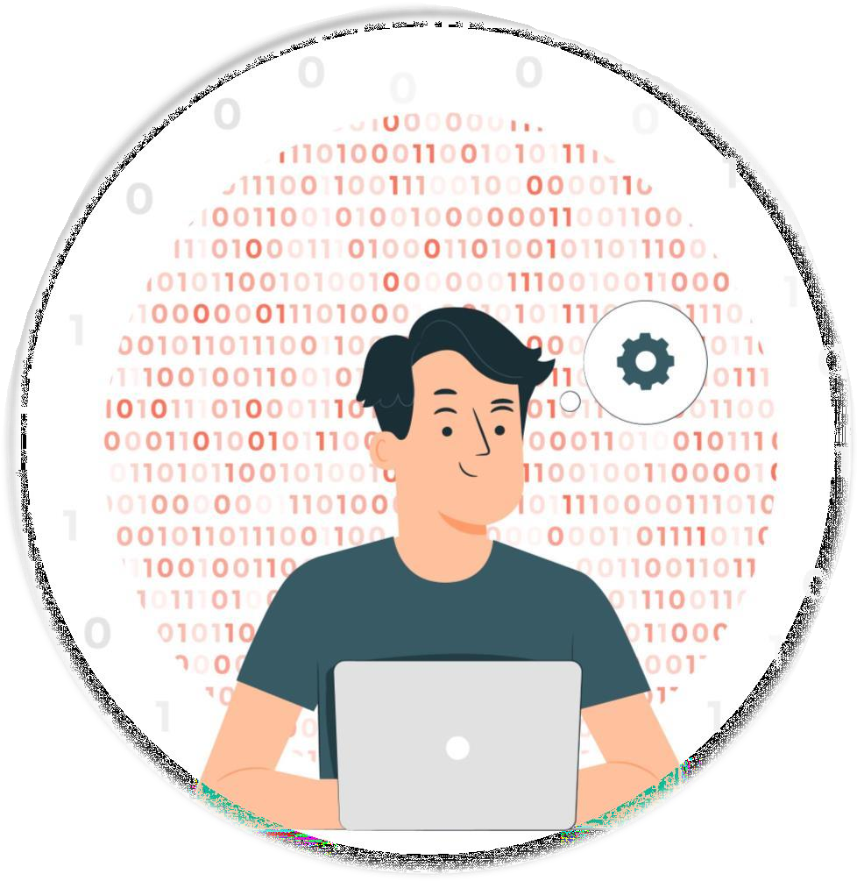
Problems Definition:-

Slide 10

Problem 1
Late detection of diseases
Solution:-
Early detection of diseases through an image of the eye and pictures of some of the required analyzes

Slide 11
Problem 2
Substance abuse affects a person's life, making it difficult and dangerous to deal with.
It is safe to know if the person I deal with is a drug user or not.
Solution:-
Drug abuse detection by using AI.

Slide 12
Problem 3
##Know some information about the disease and know the nearest
specialist doctor :
Some face some problems in knowing the locations of doctors or in knowing some information about the disease if they have it.
Solution:-
When the infection is confirmed the user is allowed to know the nearest specialist doctor points to work on.

Slide 13

Objectives:-
Create a secure, easy and smooth program to deal with.
Early detection of some diseases such as (1-diabetes, 2- Cataract, 3- glaucoma) with AI.
Using AI to knowing the nearest specialist doctor and some information about the disease and how to deal with it.
Drug abuse detection.

Slide 14
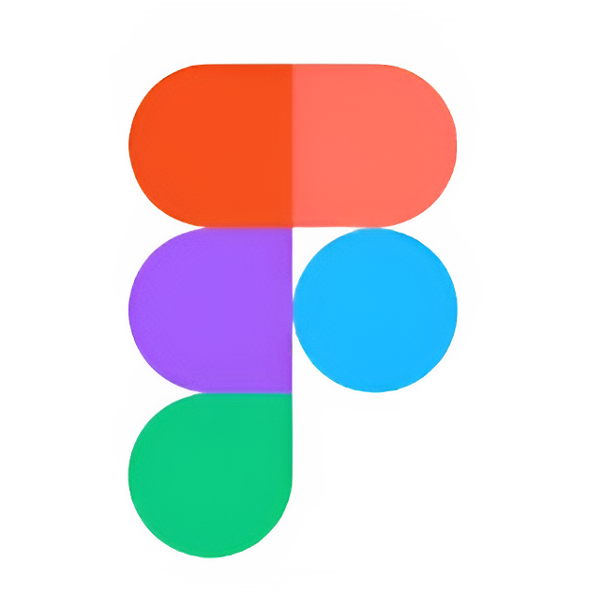


Courses Used:-
Figma
Adobe illustrator
Adobe photoshop

Slide 15
THANK YOU

